Slide 1

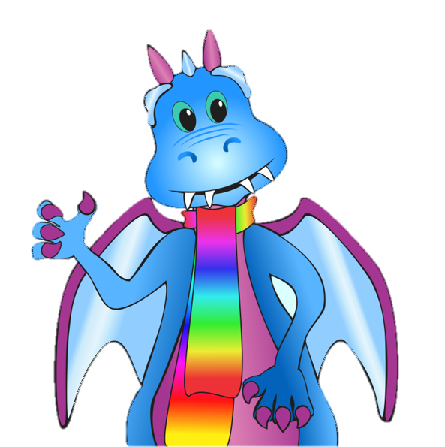
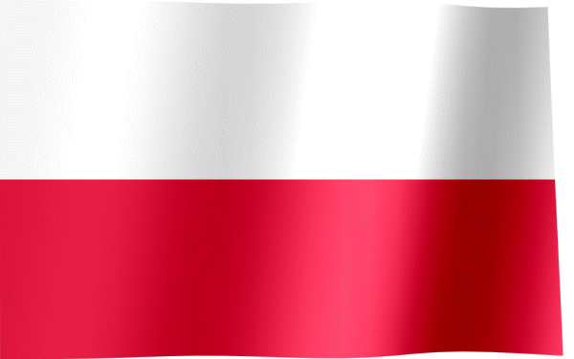

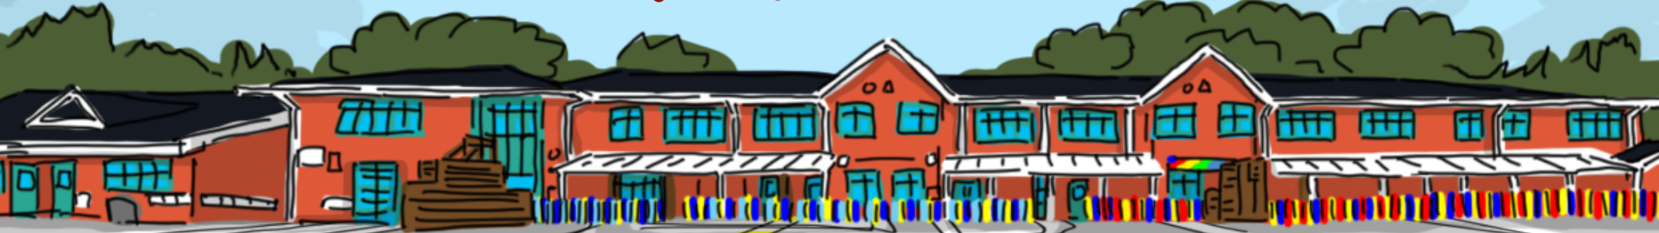
Language of the month
Polish
Article 8 – Every child has the right to an identity

Slide 2

Where is Polish Spoken?
Polish is the official language of Poland, which has a population of 39 million people. There are big Polish-speaking communities in Argentina, Australia, Belarus, Brazil, Canada, Germany, Lithuania, the UK, the Ukraine, the US and Russia (among many other countries).

Slide 3
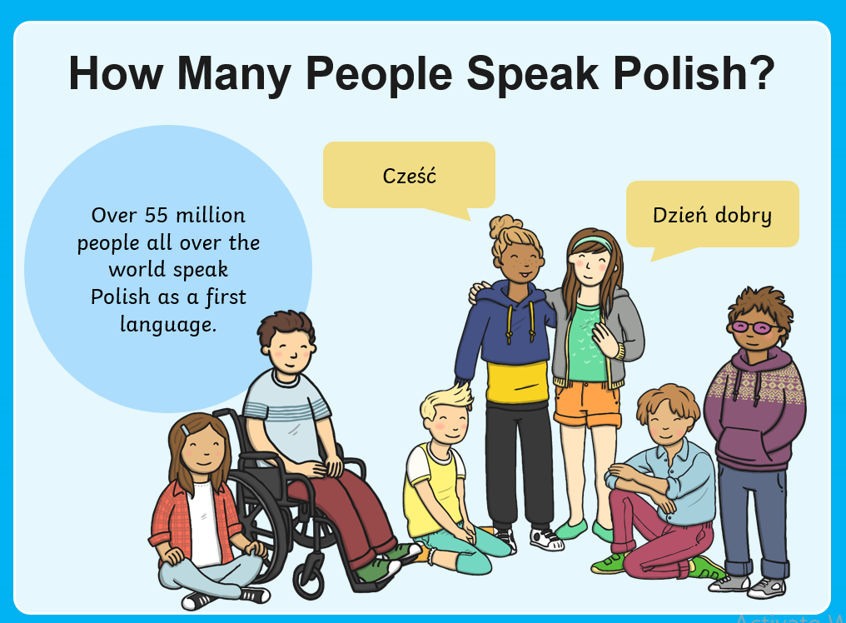
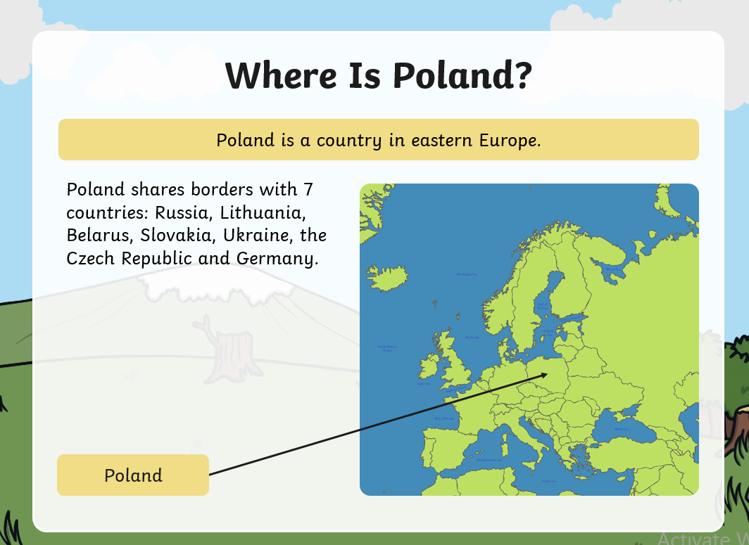

Slide 4
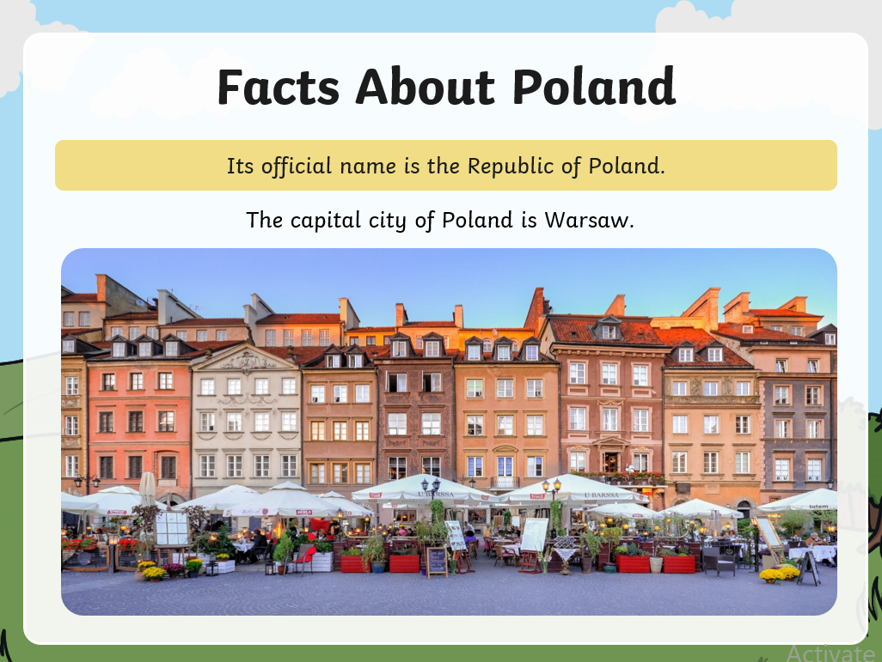
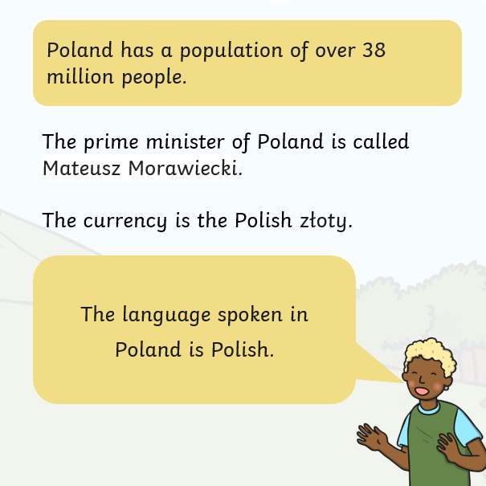

Slide 5
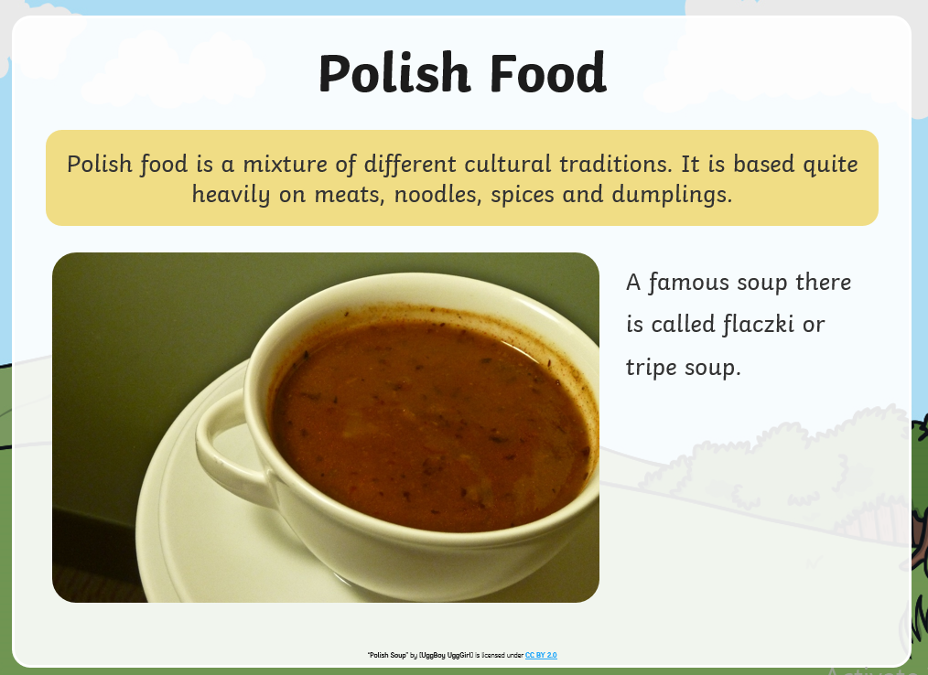
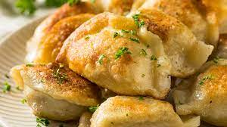
Pierogi is undoubtedly Poland's most famous and simple comfort food. These dumplings can be cooked or fried; stuffed with meat, vegetables, cheese, fruit, chocolate; accompanied by a sour cream topping or just butter.

