Slide 1

Croeso i Blwyddyn 1
Article 28 – All children have a right to an education

Slide 2

Staff
Year 1 KP/SG
Teachers – Mrs Palmer/Mrs Gillett
TA – Mrs Davies, Mrs O’Leary
Year 1 HC
Teachers – Miss Christer
TA – Mrs Aldali, Mrs O’Leary

Slide 3
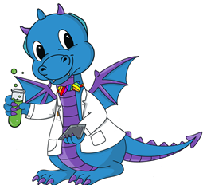





The children are taught through 6 areas of learning, these are :
Language, literacy and communication
Mathematics and numeracy
Health and well being
Expressive arts
Science and technology
Humanities

Slide 4




In Sketty Primary, we want our children to be:
Ambitious, capable learners
Healthy, confident individuals
Enterprising, creative contributors
Ethical, informed citizens
These are referred to and embedded in everything we do.

Slide 5
Topics
Autumn Term
As Far as the Eye can See – This is a Humanities topic. We look at our immediate environment and then what we can see in the distance- down to Mumbles Lighthouse- comparison work.
Text – The Lighthouse Keeper's Lunch.
Topic immersion Day -dress up as a character from the
book. Wednesday 16th September
Diwali and Christmas market.
Spring Term
Curious Creations – Finding out about how things work, are made, where things come from.
Summer Term
Wild Things – This topic has a science and technology focus. Butterfly life cycle- in the class.
Text-Where the Wild Things Are.

Slide 6

Adult Focus Activities
We generally teach in small focus groups- including language, Welsh and topic work.
During Active Learn there are a range of challenges to complete in each room which allow children to practise previously taught skills independently.
As in Reception, the children have access to a range of provision within the classrooms and outside.

Slide 7
Reading
We teach reading through daily phonics and shared reading.
Children will have an individual reading book which will be changed
weekly and they will have a set reading day. Please send in the reading folder on this day. They will also have new keywords to learn each week. These will be recorded in their reading journal.
We need you to read with your child to consolidate their learning,
develop fluency and go over key words.
Please use the reading record to let us know how they are getting on at home with their reading- this is so helpful! The children will also be bringing home a picture book of their choosing for you to enjoy together.
As part of homework in Year 1 we would like children to read to an adult for 10 minutes every night. It doesn’t have to be the same every night- take turns, read alternate pages, play jump in.

Slide 8
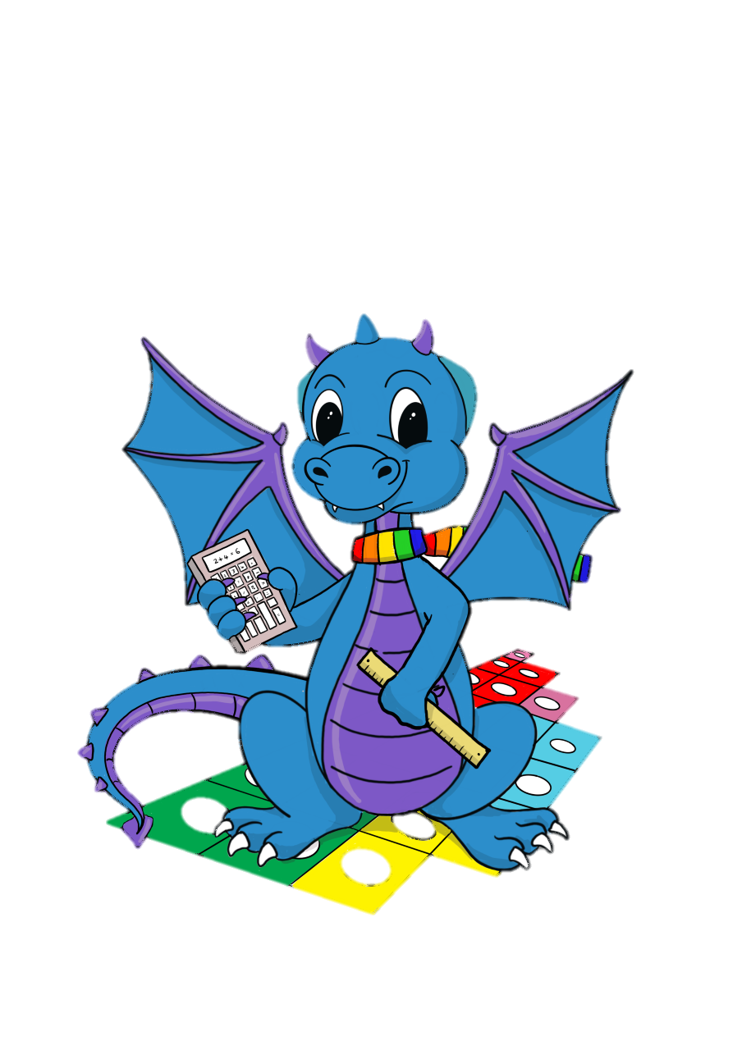
Numeracy
Each Maths session we begin with a whole class mental warm up e.g. Counting, number bonds and practising the concepts for the week etc
We will work with small Maths groups per session. During the week, all children will have the opportunity to consolidate their skills practically.
Each day the children will also have daily WWN sessions – phonics for maths.
Each term the children will be taking part in a numeracy project.
Please keep working on their number formation at home as part of their homework.

Slide 9
Emotion coaching
Each classroom has a designated calm area which they are free to access if necessary- calm cwtch.
Emotion coaching is a whole school approach to develop the children's ability to self regulate. We talk about emotions, zones of regulation and strategies to help them.

Slide 10
Things to remember
The children need to be dressed appropriately each day depending on the weather.
Fruit/ Water to be brought in a labelled container.
Please label all items of clothing & footwear (including wellies).
If your child brings their own packed lunch please make sure it is clearly labelled.
We encourage the children to not bring toys to school/have lots of keychains.
Can all the children have named wellies in school that they can leave here.

Slide 11

Health and Wellbeing
Indoor PE on Friday. Outdoor learning Thursday- physical activity/games, outdoor learning, forest school type activities.
PE Kit: Black shorts/joggers/leggings & white t-shirt for indoor PE.
Joggers or trousers and Sketty School jumpers for outdoor sessions, we will provide waterproofs where necessary. Please send your child into school already dressed accordingly on those days.
No jewellery to be worn.

Slide 12
Homework
Reading or reading type activity every night with an adult for 10 minutes
2. Maths homework – please refer to the school website for what we are covering each week which you can then reinforce at home.
3. Letter formation including capital letters, practising their name etc.

Slide 13
Consent Forms
We have sent consent forms for you to fill in online, if you haven’t completed these already can you please do so as soon as you are able.
These are
Pick up from School
Digital consent

Slide 14
Communication
If at any point you need to speak to us then please us dojo or speak to us at drop off / pick up, when appropriate.
Please ensure you regularly read the messages on class dojo as this is our key method for communication.
We also update the Year 1 Page on the School Website weekly so that you know what we are covering in class. We now also have a monthly newsletter which will be posted on our website and dojo.

Slide 15
Thank you

