Slide 1

Croeso i Blwyddyn 3
Article 28 – All children have a right to an education

Slide 2
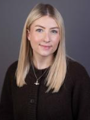
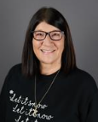

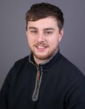
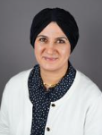
Staff
Year 3 AB
Teacher – Miss Baldwin
TA – Miss Cook
Year 3 WD
Teacher – Mr Dunt
TA – Mrs Jama

Slide 3
Topics
EPIC Planning to lead the focus – Cynefin
•Autumn Term: A Step Through Time (Humanities)
•Spring Term: Food glorious food! (Science and Technology)
•Summer Term: Wonderful Wetlands (Health and Wellbeing/ Science and Technology)
Each term there will be a range of trips and in school experiences to enhance their learning.
Our first will be an immersion day next Friday and then soon a
trip to the copper works and hopefully a chance to go on the
copper jack boat.

Slide 4
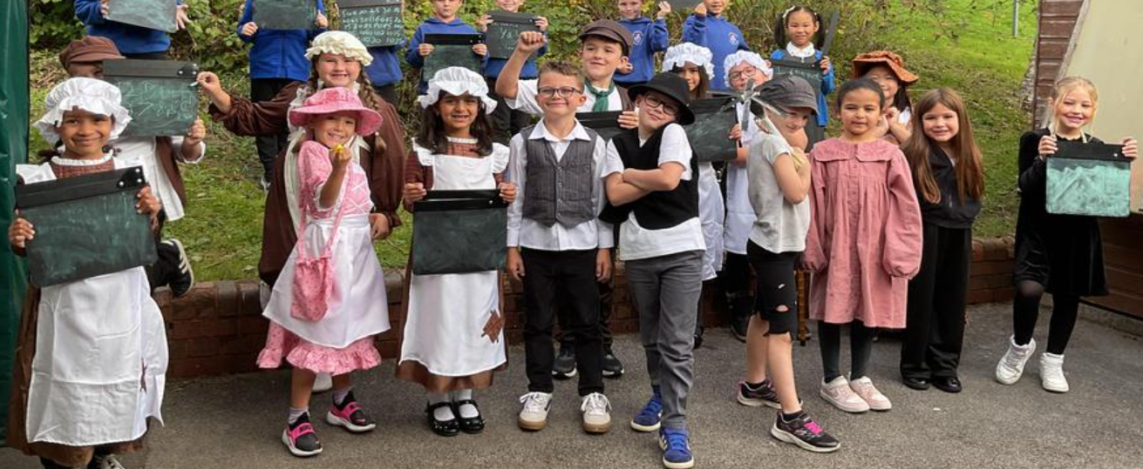
Topics

Slide 5

Literacy writing opportunities.
Recount writing
Instruction writing
Discussion writing
Poetry
Persuasive text
Language, Literacy and
Communication
Cymraeg
First person sentence patterns – Dyma fi!
The weather – past and present tense
Food -Likes and dislikes
Reading – group and class shared reading
Conversations – siarad, siarad, siarad! Past and present tense.
Although language runs through everything we do, we also teach language including Welsh in focus groups.

Slide 6

Reading and phonics
In year 3 we read with the children in a variety of ways:
Individual reading – The children's reading journal and book should be returned to school each day. Please can you use the reading record to let us know how they are getting on.
Group reading: reading with a shared text based on focus sounds in phonics groups.
Class novels
This year we are continuing the new phonics programme. The children will take part in a short phonics session every day and group reading sessions.
Reading journals – Key words included, these should be learned by sight. If you need any support with reading at home please let us know.

Slide 7
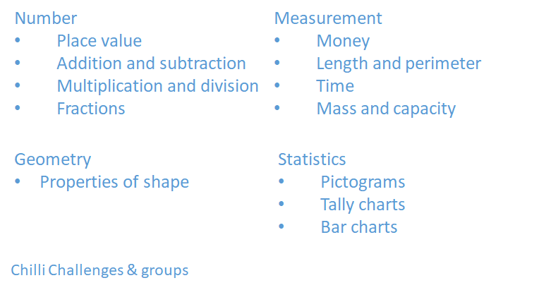
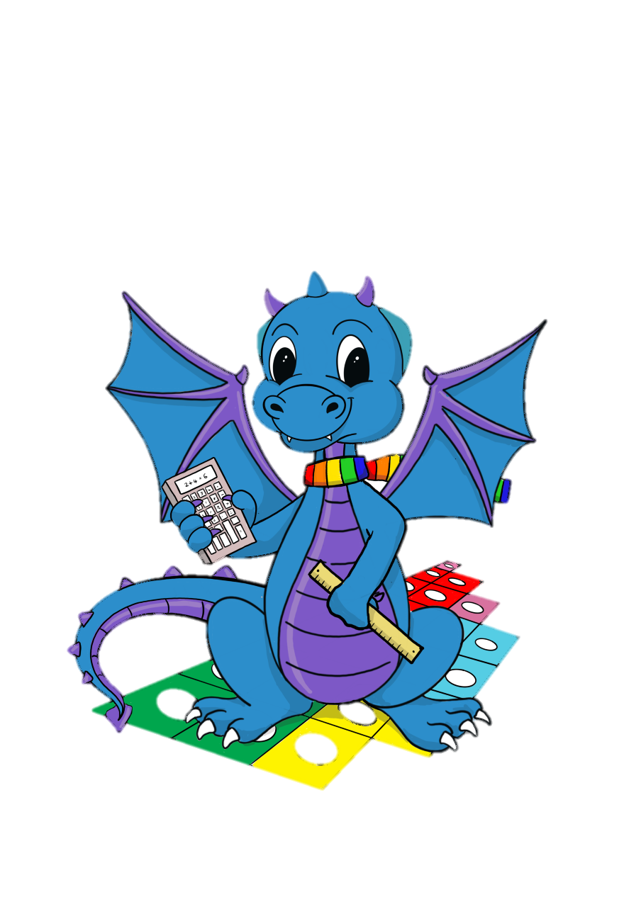
Numeracy

Slide 8
Outdoors
We use our outdoor area and wider school grounds as part of our maths and literacy sessions.
We kindly ask that all children bring a pair of wellies to school should we need them.
We try to use our forest area once a month for well-being and risky play.
In the spring term we will use the garden area and would be great to have someone with green fingers to help!

Slide 9
Emotion coaching
Emotion coaching is a whole school approach to help children to understand the different emotions they experience, why they occur and how to handle them- self regulate.
Each classroom has a designated regulation station which they are free to access if they wish.

Slide 10
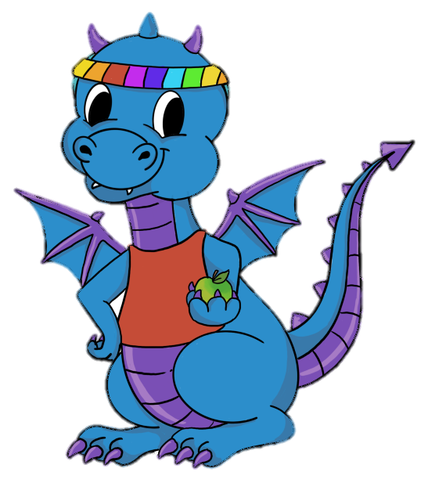
PE
PE Kit: Black Shorts/leggings/joggers & white t-shirt for PE. Please send your child into school already dressed in kit.
Thursday afternoon – indoor and outdoor P.E
No jewellery to be worn.

Slide 11
Communication
If at any point you need to speak to us, then please dojo us or speak to us at drop off / pick up.
Please ensure you regularly read the messages on class dojo as this is our key method for communication.
If anything changes with pick up during the day, please contact the school office.
We also update the Year 3 Page on the School Website weekly with messages, what we have done and plan to do and calendar.

Slide 12
Consent Forms
We have sent consent forms for you to complete online, if you haven't filled these in already can you please do so as soon as possible.
These are
Pick up from School
Use of photographs / videos etc

Slide 13
Homework
Reading every night with an adult for 10 minutes.
2. Maths homework – This is not an expectation. Everything we cover during the week will be on our Website page.
3. Spellings - new list each Thursday (cold task). To be quizzed the following Wednesday (hot task). They will need to bring their spelling journals on Thursday to write their chosen challenge words in.

Slide 14
A Few Things to remember
The children need to be dressed appropriately each day- weather dependent.
Fruit/ Water bottles to be brought in a labelled container.
Please label all items of clothing & footwear and lunch boxes.

Slide 15
Diolch yn fawr!
Thank you for coming!
Any questions?

