Slide 1

Welcome to Reception
Croeso I dDerbyn!
Be the best you can be
Gwnewch eich gorau glas

Slide 2
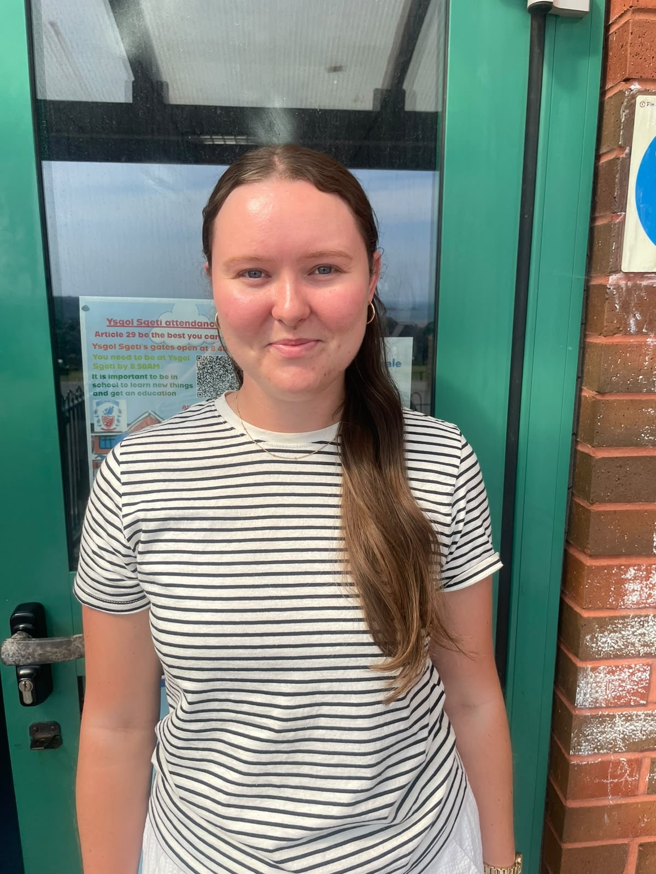
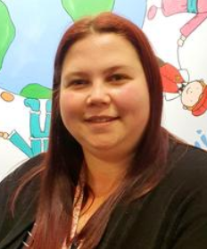
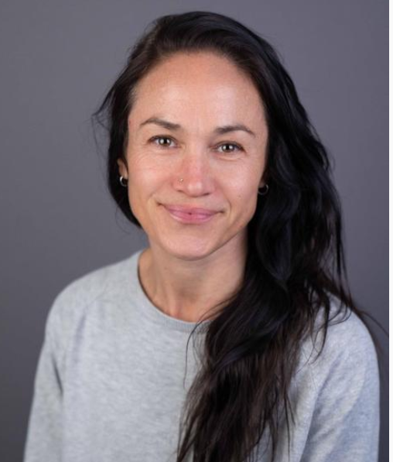
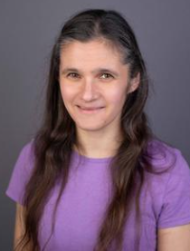
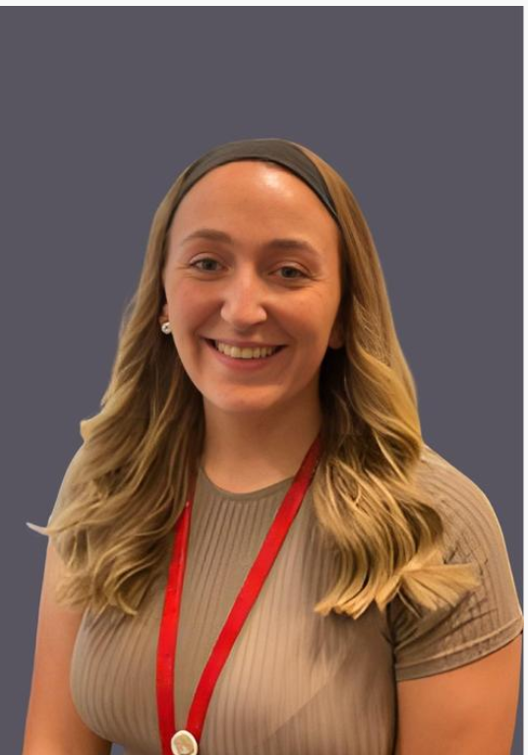
Meet the Staff
Reception Teachers
Miss Ellie Rees
(Mon-Tues)
Mrs Sara Porter
(Weds – Fri)
Miss Emily Jones
(Full time)
Reception Teaching Assistants
Miss Sophie Wright
Mrs Sarah Jenkins
Mrs Emily Jenkins-Davies

Slide 3
First week of September
Tuesday 1st September
Inset Day
Wednesday 2nd September
Inset Day
Thursday 3rd September AND Friday 4th September
The school gates will be open from 8.40am until 9:00 am.
School days for this week only (8.50am-1.30pm)

Slide 4
Our Daily Routine
School starts at 8.50am. We open our doors at 8:40am so that teaching time starts at 8:50am. Teachers will greet you and the children at the Reception Classroom gates.
8.50 am- Register, welcome activities and check-in.
9.15am – Active learn/Maths (indoors and outdoors)
10am – Snack time and Playtime
10.20am – Phonics carousel (indoors and outdoors)
10:40am – Active learn/Literacy (indoors and outdoors)
11.45am – Lunchtime
12.30pm – Register, Slot drilio
1.00pm – Active Learn
3:00pm – Story, songs and check out
3.20pm – Home time

Slide 5
Lunchtime Arrangements
The children can either bring their own packed lunch or opt for school dinners as hot dinners are provided for Reception children free of charge. The menu can be found on Swansea School Dinner Menu
The children eat in the main hall and then go outside into the playground to play. On wet days the children return to their classroom to play after they have eaten their dinner.
Reception children eat in the hall with Year One and Two.
Please go over the school dinner menu with your children every day before coming to school as they will need to tell us what they are having for dinner each morning during registration.

Slide 6
End of day arrangements
The children will be dismissed from the classroom doors at the end of the day one by one-Just like they were in nursery.
Please let us know end of day pick up arrangements. There is a form to complete online regarding end of day collection that will be sent out to you in September. Just follow the link provided on the Dojo message (we will send the link out to the form on 1st September)
If circumstances change at any time, please speak to the Reception team so we can amend the form.

Slide 7
Breakfast Club and After School Club
All children can attend Breakfast Club which runs from 8am until 8.40am. They must be registered and there is a small daily fee for attending- £1.55p. The children who attend are then brought straight to the classroom ready for registration. Please contact the office on Sept 1st if you need to activate your ipay account.
After School Club-Sketty Kids Club. It is run by Miss Helen Reeves, who rents our school premises. There is also a charge for this. Please look on our website if you require further details.
SKIP club will start in September that will be available once a week. (Reception after school club).

Slide 8
Fruit Snacks and Water
The children will need 2 fruit snacks in school in clearly named boxes. There will be fruit boxes where the children can put their fruit on arrival.
Each child also needs to have a bottle of water (named) in school. This will go home every day to be refreshed.

Slide 9

PE Kits and outdoor learning
The children will come to school dressed for PE on their allocated PE day (TBC) -We do not keep PE kits in school.
For PE the children will need dark coloured shorts/leggings, a white t-shirt and trainers.
Please make sure your child is not wearing any form of jewellery too on these days for health and safety reasons.
On the children's outdoor learning days (TBC) children MUST have spare clothes with them in their bags in case a change of clothing will be needed due to clothes getting muddy, wet etc. Please ensure children come to school in appropriate clothing for outdoor learning.

Slide 10
SKIP-Successful Kinaesthetic Improvement for Pre-schoolers
The aim of the programme is to develop children’s fundamental motor skills (FMS), so they can successfully engage in a variety of sports in years to come. Children need to be proficient in their FMS by age 7.
FMS include: bouncing, catching, creeping, crawling, dodging, dribbling, galloping, hopping, jumping, kicking, leaping, pulling, pushing, rolling, running, skipping, sliding, striking, swinging, throwing, turning.
SKIP is carried out in weekly sessions in the school hall as part of our P.E sessions, plus we include a variety of activities in our provision throughout the week.

Slide 11

How we develop reading skills
In Reception, the children will continue to work on their recognition of sounds alongside developing their ability to blend sounds orally. When children can blend sounds orally this can then be transferred to reading words. Moving on to writing, children use their oral blending skills in order to spell words phonetically.
How can you support us at home?
The sounds that are practiced in class will be sent home (like in Nursery) please can you display them or put them in a book and practice recognising them each day.
Oral blending (start with 3 sound words and progress to 4)
You want to develop a love of reading with your child through an enjoyment of stories and books, so please read stories or books to them every day when possible. (repetitive stories are perfect for getting your child to join in with you so that they feel that they are a reader) E.g - we're going on a bear hunt, the gruffalo, a squash and a squeeze.
On the 8th September there will be a phonics parent workshop that we advise you to try and attend as this will also help to support your child at home, and will give you a further insight into how our phonics scheme is used.

Slide 12

Drawing Club
Drawing club is an approach we use in Reception in order to develop children’s writing skills along with their imagination and creativity, and most importantly their motivation to write. Each week there will be a different stimulus, this could be a story book, fairy tale or animation and alongside this, the children will listen to new vocabulary to develop their oracy skills. The children could be given a task to describe the setting, characters or an I wonder question and they will answer by drawing and writing. This gives the children more freedom to use their imagination and helps develops an enjoyment for writing and mark-making. Over the year, the children’s responses and writing will develop, with initial expectations of using their sounds to write CVC words, building up to short captions and then sentences.

Slide 13

Things to Remember
Continue to bring a SMALL rucksack to school every day containing a fruit or veg snack, water bottle and spare clothes.
Wellies – please bring in wellies for your child on the first week of school, these will be kept in school for the whole academic year.
Please label EVERYTHING – it really helps.
Open door policy: If you have any questions or concerns, at any time, please get in touch with us and we will arrange a mutually convenient time to speak.
Your dojo accounts will be transferred from Nursery to us.
This presentation will be put on the school website on the Reception web page www.skettyprimary.co.uk
Please visit our school website and class page to see a variety of photos and information about life in Sketty School and Reception.
Thank you for listening.
Any questions?

